Slide 1
Where to Open a Coffee Shop in Brisbane Australia
Using FourSquare API data

Slide 2
Problem
Retail, especially food is a narrow margin business
Selecting a location is critical for business success
One key aspect is to ensure limited competitors are in the same area

Slide 3
Data used
Used government data of neighbourhoods for Brisbane postcodes:
Inner-Brisbane,
North-Brisbane,
South-Brisbane,
East-Brisbane,
West-Brisbane
Used Folium to generate a Map

Slide 4
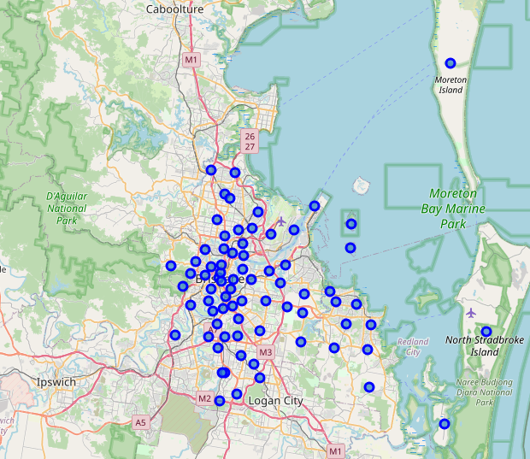
Folium Map
Blue dots represent each postcode location in the 5 areas (75 in total)

Slide 5
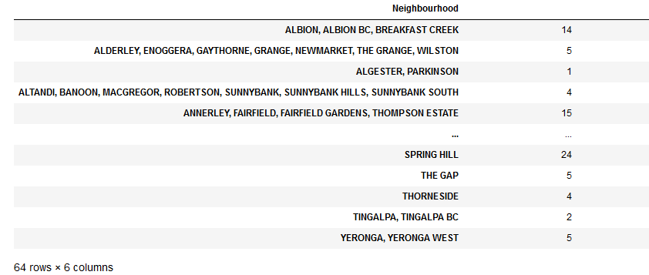
Methodology
Extracted venue information with Foursquare API
Resulted in 563 venues across 64 postcodes
Not all postcodes had Foursquare data

Slide 6
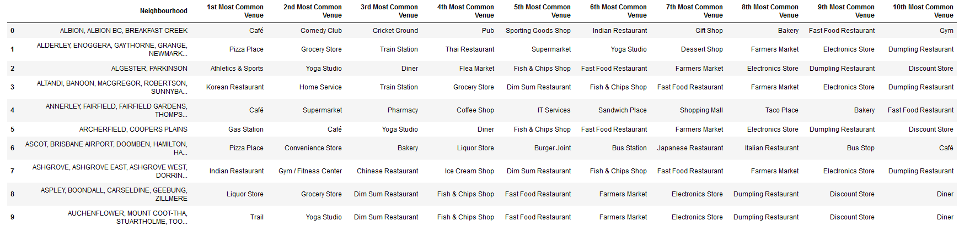
Methodology
Used one-hot-encoding to transform categorical values, display 10 most common venues per neighbourhood

Slide 7
Methodology
Filtered by “Coffee Shops” reducing the 64 postcodes to 51 remaining postcodes
Filtered by “Café” reducing the 51 postcodes to 35 remaining postcodes
Filtered by “Bakery” & “Diner” reducing the 35 postcodes to 11 remaining postcodes
Filtered by “Grocery Store” reducing the 11 postcodes to 7 remaining postcodes

Slide 8
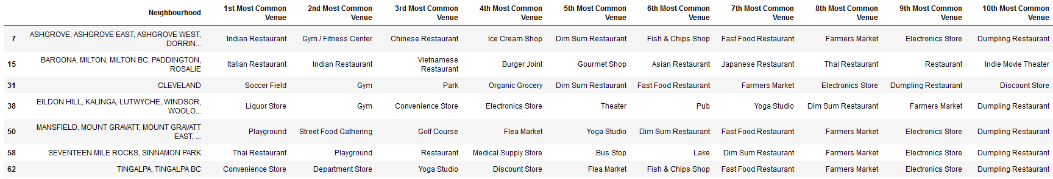
Final 7 options

Slide 9
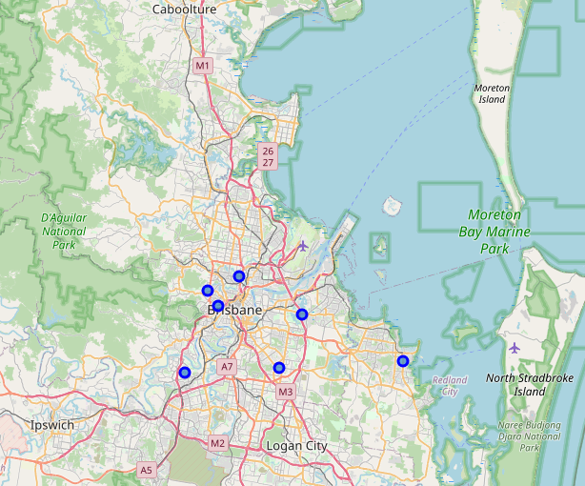
Folium Map
Blue dots represent each postcode location in the 5 areas (7 in total)

Slide 10
Results & Discussion
Shows at least one option in each of the Boroughs
Additional data would be needed to make final decision such as:
real estate data for rents,
population demographics including culture for potential customers and their tastes,
different data sources to confirm that additional coffee shops are not close by but have not been reviewed using the foursquare app

Slide 11
Conclusion
Foursquare API to identify potential coffee shop locations was shown to be useful in getting reviews of various venues within the region selected
ranking of the venues yielded useful insights into areas that had successful or well-liked coffee businesses
data presented is the first step to starting a new business venture
Next step is to identify suitable venues that are commercially viable and readily visible to sufficient foot traffic

